Slide 1
Minds, Machines, Persons
The Mind and Body: Part 1

Slide 2
Overview
What is a mind?
Cartesian Substance Dualism
Interactionism
Problems with the theory
Alternative form of Dualism:
Epiphenomenalism

Slide 3
What are minds made up of?
Some terminology in metaphysics:
Substance- something in which properties inhere (Kim)
Object that instantiates (or has) properties
Substances also have the capacity for independent existence
Logically possible for it to exist on its own
Thought experiment: The baseball universe
Properties can be predicated of things: weight, shape, color, volume
Weight is dependent upon some object or thing that has it
Unlike substances, you cannot just have properties free-floating (color red in the other room, but no object is red)

Slide 4
The nature of body
Descartes at first thought he was essentially a human organism
In light of developments in 17th century science, organisms, including human bodies, were understood as machines with intricate parts
Descartes: “I suppose the body to be nothing but a statue or machine made of earth”
Machines exist at a location in time and space (Makes sense to ask where is the machine? When did it come into existence?)
Machines are made up of matter (tiny particles that have size, mass, etc.)
Descartes: Am I essentially a machine?
Would I no longer exist if you were to destroy my body?

Slide 5

Mirror thought experiment
One test: Is it coherent to conceive of my mind existing without a body?
Conceivability test
Descartes: Yes!
Takeaway: It’s (logically) possible for the mind to exist without the body
Still might be physically impossible

Slide 6
Mind and body
Descartes: There are good reasons to think the mind and body are distinct substances
Conceivability argument:
P1. It is conceivable that the mind (A) can exist without body (B)
C. Therefore, it is (logically) possible that the mind can exist without body.
P3. If it’s (logically) possible for A to exist without B, then A & B cannot be one in the same object (Leibniz’s law)
C. Therefore, the mind and body are distinct objects/substances
Upshot: Humans are made up of two separate objects (i.e. a mind and a body)
Remaining question: What are these objects made up of?
Notes:
Routledge

Slide 7
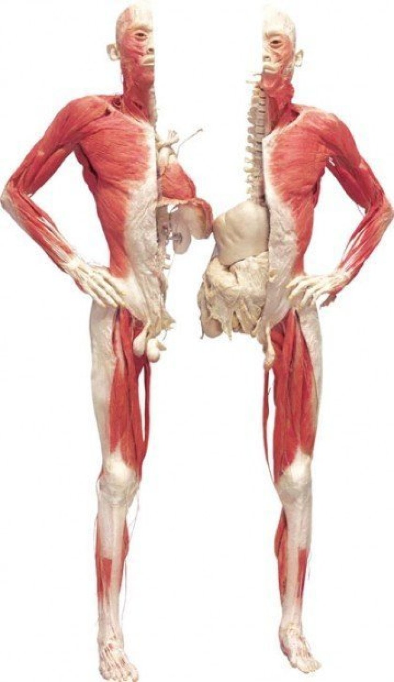
Mind and Body
Second argument for the division of the mind and body
“we cannot conceive of half a soul, as we can in the case of any body, however small.”
The divisibility argument
P1. I can divide my body into parts
P2. I cannot divide my mind into parts (Indivisibility thesis)
P3. If A and B are identical, then they must share all of the same properties (An object cannot be both divisible and indivisible at the same time)
C. Therefore, the mind and body are distinct
One object that is divisible, the other indivisible

Slide 8
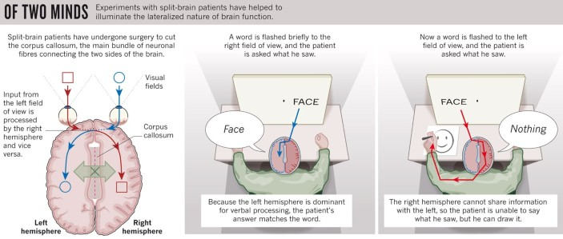
Indivisibility thesis
Why does Descartes believe the mind is indivisible?
Argument for indivisibility of the mind:
P1. I cannot detect parts of my mind (via introspection)
P2. I perceive a unity of the mind (via introspection)
C. The mind has no parts
Assumption:
We have access to everything that goes on in our minds
Modern psychology/cognitive science: Descartes is wrong
Unconscious mental states
Case studies of brain injury and genetic abnormalities
Split brain cases
There are parts of the mind!
Notes:
If you split the brain in two, you split the mind in two as well! Two hemispheres of the brain no longer communicate to each other, but the information is still being processed nonconsciously. Results in interesting behaviors.
Prosopagnosia as second example (missing the facial recognition part of the mind). Humans can quickly recognize familiar faces (Mental capacity). But some lack it. Part of the mind dedicated to processing familiar faces (correlated with fusiform gyrus activation)

Slide 9

Reasons for thinking the mind is not a material object
So far, Descartes has argued that minds and bodies are different objects
Why not think there are just two material objects, a material mind and a material body?
Material objects have properties like mass, shape, and size
Minds do not have these properties
Minds have (mental) properties like: thinking, feeling, wishing
Material objects do not have mental properties
Rocks cannot think
Chairs cannot feel
Stars cannot wish
Descartes: Minds fall under a completely different category than material objects
Minds are made up of an immaterial substance

Slide 10
The nature of mind
What is a mind?
Descartes: Mind- a thinking thing (p. 7)
What is a thinking thing?
Denotative def: a thing that believes, doubts, desires, perceives, imagines, wills, etc. (8)
Thinking is the essential attribute of the mind
Mark of the mental
Descartes believed that thought necessarily involves consciousness
Some dispute over his views on intentionality
Might have held the view that some conscious thoughts were not intentional

Slide 11
Substance dualism
Cartesian version*
Two fundamentally different kinds of substances in the universe
Mind and Matter
Each of the substances have their own unique properties
Material substances
Exist in time and space
Extension
Mental substances (souls)
Exist only in time (Nonspatial)
Thought
Humans are a union of matter and mind
Notes:
Substance is a bearer of properties. A thing or an object.

Slide 12
Understanding Substance Dualism
What are the fundamental substances that make up all of the things in the universe?
Matter is one of the substances
Tables, chairs, rocks, stars, water, plants, and the bodies of animals
Are there any other substances?
When God created the universe, did he just have to create matter, or did he need to include any extra ingredients?
Substance Dualists say that God needed to add a second mental substance

Slide 13
Understanding Substance Dualism*
Humans have minds and bodies (made up of two different substances)
The mind is what makes you you
The body is just a vessel for the mind
Body swapping thought experiments
The mind (typically) controls what some of the body does
There is interaction between our mental states and brain states (causal interactionism)
When I voluntarily lift my left hand, a mental substance (my mind) causally interacted with a material substance (my brain)
When I stub my toe, a material substance (a table) causally interacts with a mental substance (my mind)

Slide 14
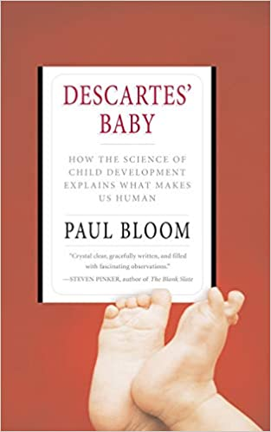
Dualism
(Substance) Dualism might be construed as the commonsense view of the mind
Ingrained in folklore, popular culture, and major world religions (Eastern and Western)
Christianity, Islam, Hinduism, Buddhism
Belief in dualism might be innate
Paul Bloom’s work in developmental psychology
Babies naturally divide the world into two
Folk physics vs. Folk psychology
Commonsense views are sometimes mistaken
Still, one could argue that the prevalence of dualism provides some support for the theory

Slide 15

Obj 1: Causal interaction problem
Mind and body made of completely different kinds of stuff
Princess Elisabeth: How is it possible for them to causally interact?
In space?
Descartes: No. Minds don’t exist in space
How can two things causally interact if one is in space and the other is not?
Seems like two things need to contact each other in order to causally interact
Descartes accepts this assumption (contact mechanics)
Descartes: Intermediate step between mind and body
Pineal gland is the seat of the soul
Further problem: How does the mind causally interact with the pineal gland? How does the pineal gland send signals to an object outside of space?
Descartes: It’s a mystery (no rational explanation)
Notes:
Descartes’s own theory of physics required that all forces interact via contact. The Descartes correspondence letters are all we have from her in terms of writing about the mind. Also has exchanges with famous scientists of the timew (e.g. Christian Huygens) We can infer she was very knowledgeable about philosophy and science.

Slide 16
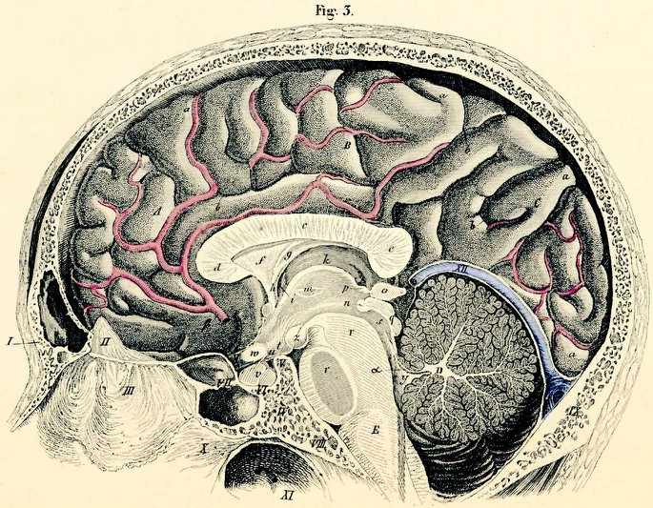

Slide 17
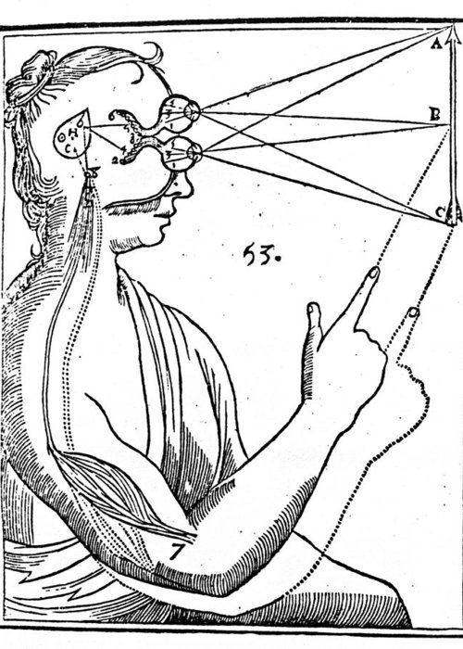
Why the pineal gland?
1) “I cannot find any part of the brain, except this, which is not double”
2) It is small, light, and easily movable
3) Located in the center of the brain
4) Well protected area
Contrary to popular belief, Descartes did NOT believe that nonhuman animals lacked a pineal gland
God has not given animals a soul to rationally control the machine
Animals act only on instincts and triggers to physical stimuli

Slide 18
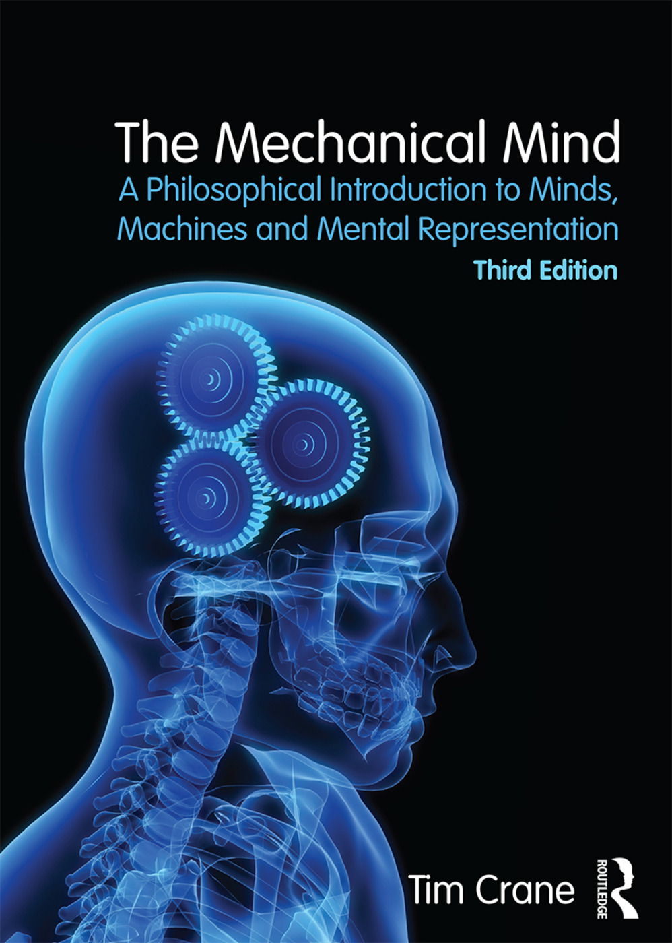
Obj 2: Mechanical mind is simpler
Princess Elizabeth: “it would be easier for me to concede matter and extension to the soul than to concede the capacity to move a body and to be moved by it to an immaterial thing”
Hobbes: ‘I can explain all the workings of the mind using only material resources. What need is there to postulate an immaterial mind when this perfectly good, and more minimal, explanation is available?
Immaterial substances aren’t necessary to explain mentality
The mind can be understood as material in nature
Complex machine with parts
Materialism

Slide 19
Implications of substance dualism
The possibility of minds without brains (or bodies)
Ghosts
Angels
Gods
Afterlife
The possibility of mental states interacting with physical matter that is not connected to the body (action at a distance)
Minds can interact with bodies at a distance, why not other objects?
Telekinesis (minds interacting with objects)
Telepathy (communication between minds)

Slide 20
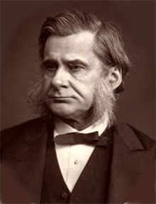
Other forms of dualism
While Descartes favored a version of dualism that is committed to causal interactionism (the view that the mind and body interact with one another), there are other versions that avoid the problem of causal interaction
Epiphenomenalism- the view which states minds (souls) exist but have no causal powers
Mental states are caused by changes in the brain
Like the sound of a steam whistle is caused by the engine of a train (Huxley’s example)
Steam whistle doesn’t causally interact with the train (just a byproduct)
Causality flows from the train to the whistle, not the other way
Commonsense picture: mental states cause brain states
Disappointed hopes cause sadness; Fear causes flight
Epiphenomenalism rejects the commonsense picture

Slide 21
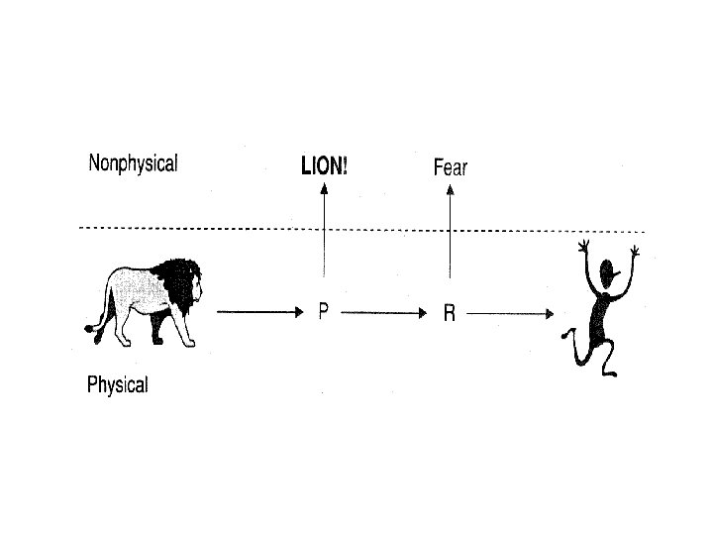
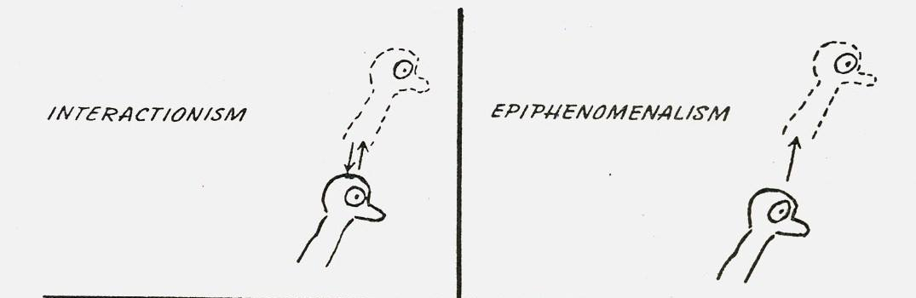

Slide 22

Huxley’s argument for epiphenomenalism
First makes the case that epiphenomenalism is true of the “brutes” (nonhuman animals)
Supporting evidence: Dissection studies with frogs reveal that they behave the same even if you remove tissues associated with consciousness
Complex behavior remains without consciousness
He then implies that these arguments work equally well for humans
Supporting evidence 2: Case studies involving human subjects (Sergeant F)
Upshot: Consciousness is caused by the brain, but consciousness doesn’t do anything (we could get rid of it and still behave the same)
Conclusion: Epiphenomenalism is true of all animals (humans too)
Notes:
Huxley and his contemporaries seem to have been impressed by preparations in which frogs had had various portions of their brains removed. Reasoning by analogy with humans lesioned by disease or battle, Huxley finds it plausible that the frogs are not conscious, or not exercising volition; yet when thrown into water, for example, they swim just as well as undamaged frogs. Huxley also discusses at some length the case of a Seargent F., who had sustained a shot that fractured his left parietal bone. Once or twice a month, this soldier would have a day-long bout in which he exhibited complex behavior (e.g., singing, writing a letter, “reloading”, “aiming”, and “firing” his cane with motions exactly appropriate to a rifle in a skirmish) while being plausibly unconscious, as evidenced by insensitivity to pins and shocks, sound, smell and taste, and to a great extent, vision. Huxley allows that there can be no direct evidence showing that the soldier is conscious or not conscious; but he concludes that he may be devoid of consciousness, while performing his complex and apparently purposeful movements.

Slide 23
James’s response to Huxley
William James finds epiphenomenalism very hard to take seriously
Offers two arguments against the view
Evolutionary argument: Consciousness increases a creature’s fitness (survivability)
Plausible that consciousness plays an important function
It allows us to choose what to pay attention to
Consciousness as an experience selector
Further point: Would be a mystery why humans have consciousness if it serves no evolutionary purpose
Appeal to commonsense: Epiphenomenalism is contrary to commonsense
Therefore, it is (probably) false

Slide 24
Next Time
Responses to the mind-body problem in the 20th century:
Behaviorism
Identity Theory
Functionalism

Slide 25
